Slide 1
COMP 3064
Game Development
Game design process and documentation
Sprite animations

Slide 2
Today: More Scripting
Design and documentation of the game
Sprite animations

Slide 3
Sprite animations
Animations in 2D are built out of frames (images) showing a character in various poses
Simple animations can be combined using an engine called Mechanim

Slide 4
Sprite Animations
•
Mecanim
•
Animator View and Animator Controller
•
Animation View
•
Scripting
•
Animation triggers and transition conditions
•
More Coroutines
•
More Unity API

Slide 5
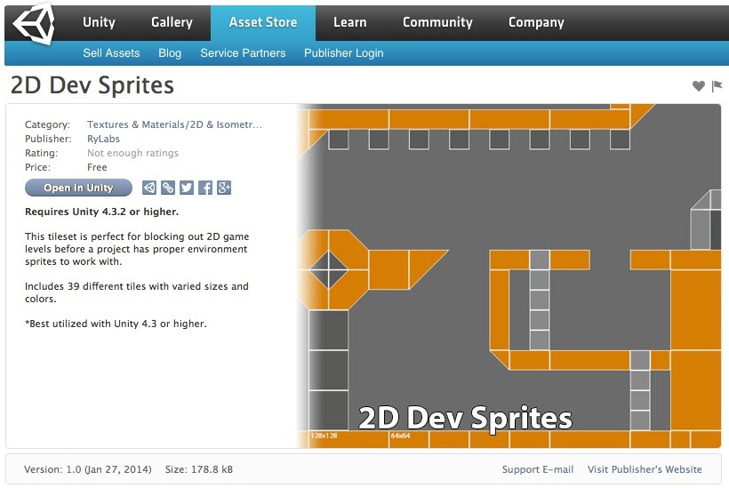


Unity Asset Store

Slide 6
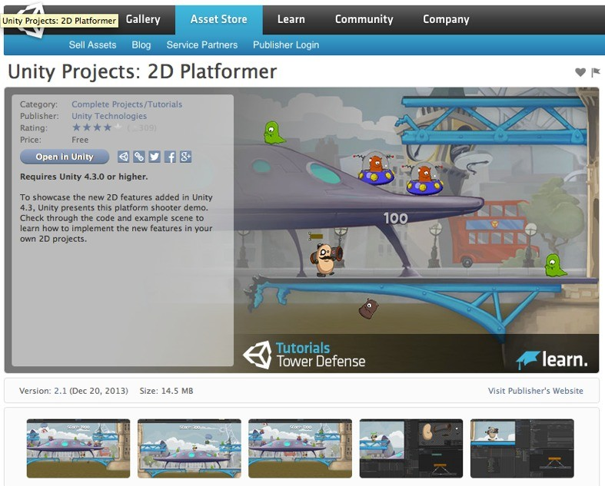

Unity Asset Store

Slide 7

Sprite Animation Creation Demo

Slide 8
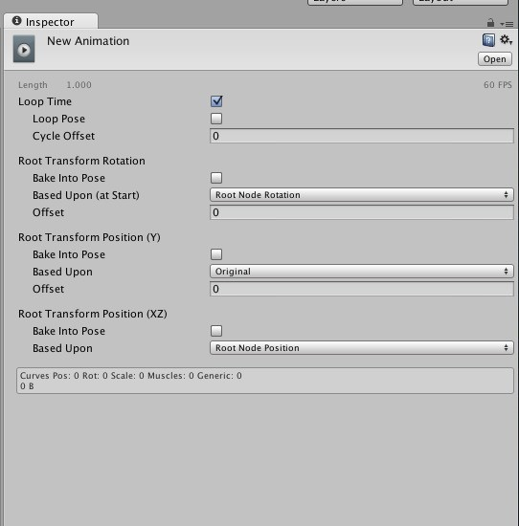

Inspector View
Whether the animation loops or not

Slide 9
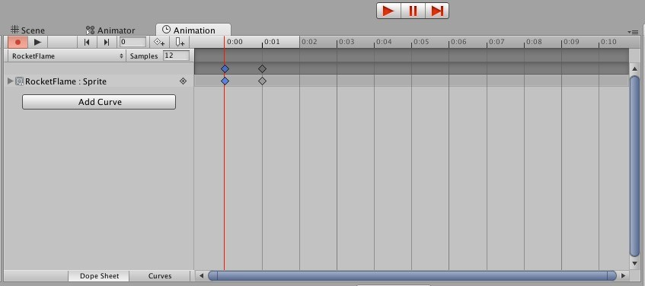



Animation View

Slide 10

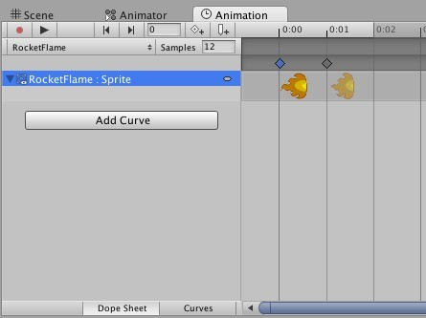

Animation View
•
You can expand the animation clip to preview each sprite frame.

Slide 11
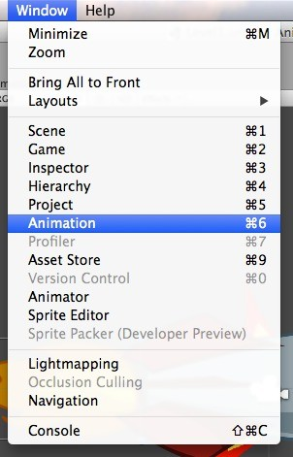
Animation View
Go to Window > Animation.
•
•
Select an animation or create a new one.
•
If no game object with an animation is selected, the Animation panel will show nothing.
•
But you can create a new animation clip within the Animation panel.

Slide 12
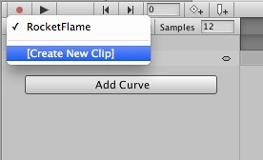
Animation View
•
Select [Create New Clip].
•
You will be prompted to save the Animation Clip asset in your project.
•
Give the Animation Clip asset a name.
•
Place it assets under an Animation folder, to better organize your project.

Slide 13
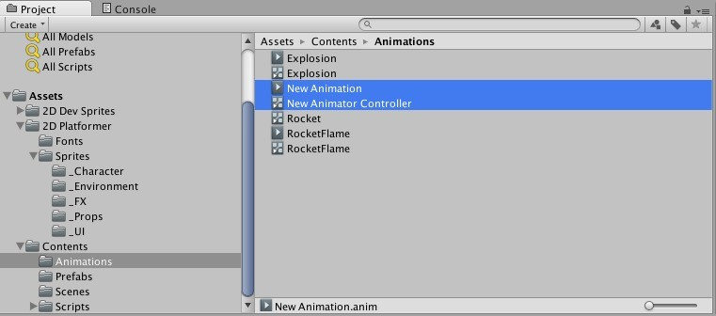
Animation View
•
An Animator Controller gets created automatically, and the new clip is added to it as the default state.

Slide 14


The Animator Controller
•
Create an Animator Controller like you would any asset.
•
In the Project View, select Create > Animator Controller or right- click anywhere empty within the view and select the same.
Asset Icon

Slide 15
The Animator Controller
•
Also gets created when:
•
A new Animation Clip is created.
•
A collection of sprite frames are dragged to the scene view to create an animation clip.
•
Animation Controllers and Animation Clips go hand-in-hand.
•
Animation Controller has states that require animations to play.

Slide 16
The Animator Controller
•
Contains one or more state machines that determine which animations are currently being played.
•
A state machine is made up of states, transitions
and the triggered conditions for each transition.
•
The machine is in only one state at any given time, called the current state.

Slide 17



Example State Machine
state transition
State 1
State 2
State 4
State 3
Triggered conditions for each state transition are not displayed here.

Slide 18



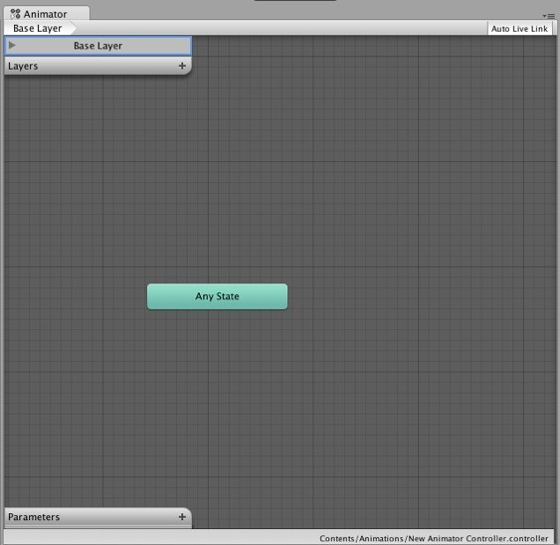




The Animator Controller
Current Layer
More Layers
Parameters

Slide 19
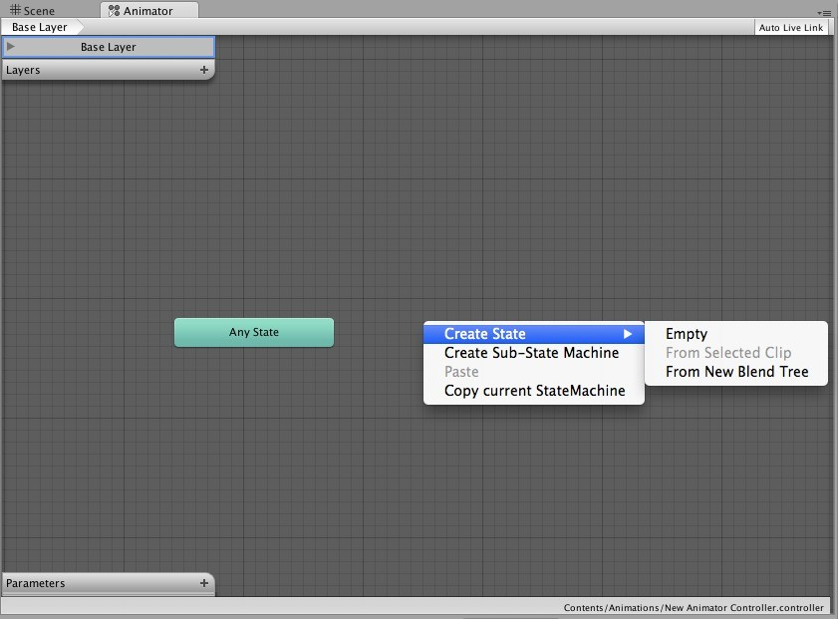





The Animator Controller
Create a new State

Slide 20
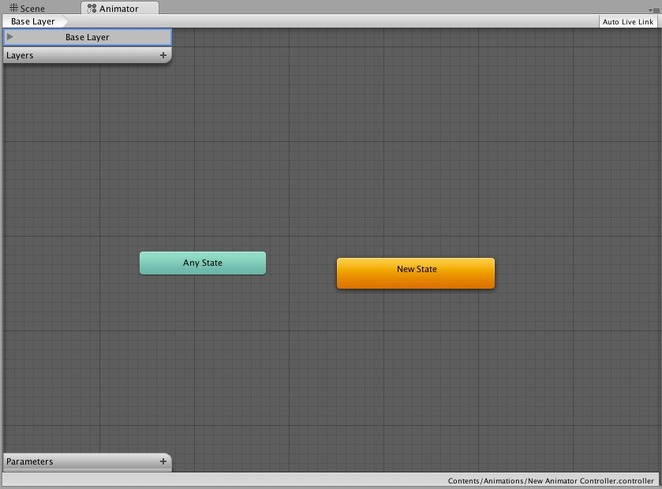


The Animator Controller
First state is automatically set as the default state, coloured orange.

Slide 21
Default States
•
Default states is the first state that executes.
•
i.e. its animation is the first to play.
•
Right-click on any state to set it to default.

Slide 22
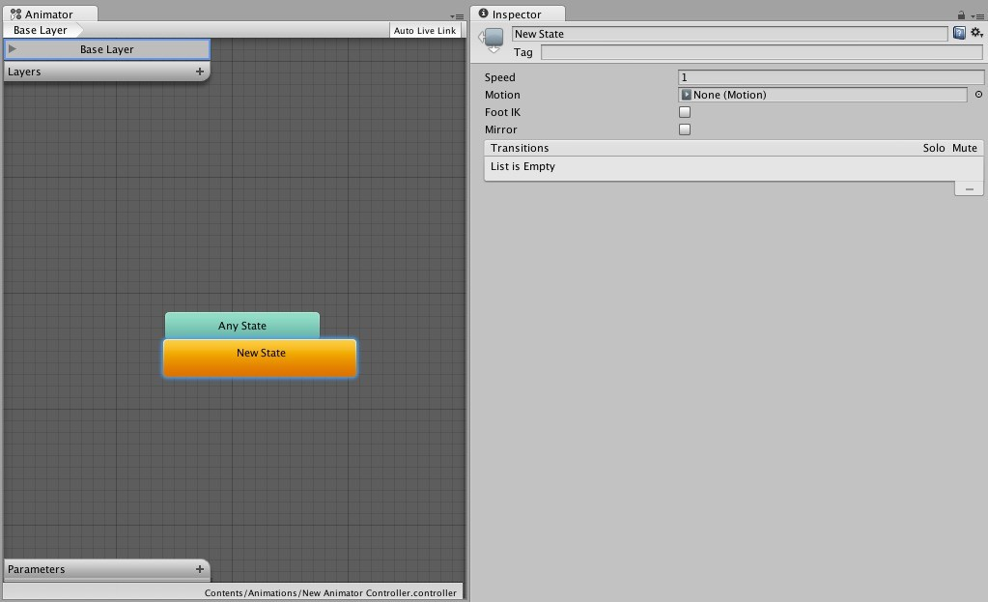









The Animator Controller
State name.
List of transitions.
There are none set.
Reference to the animation clip playing for this state.
Animation speed. 1 = default speed.

Slide 23
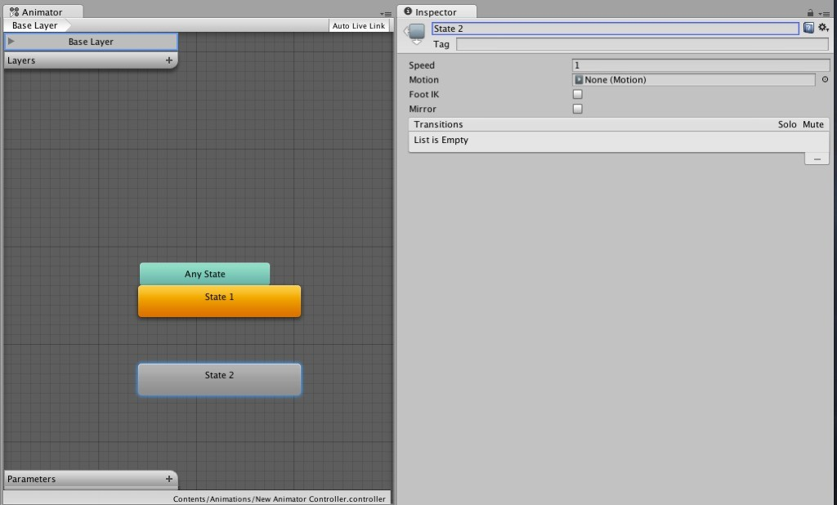
The Animator Controller

Slide 24
State Transitions
•
Right-click on a state and select Add Transition.
•
Point to another state you wish to transition to.
•
Transitions are one-directional.

Slide 25
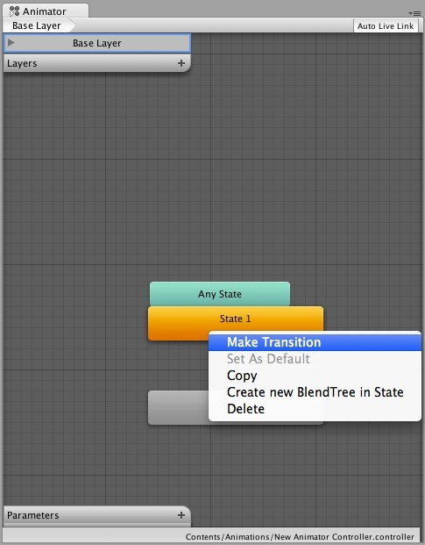
The Animator Controller

Slide 26
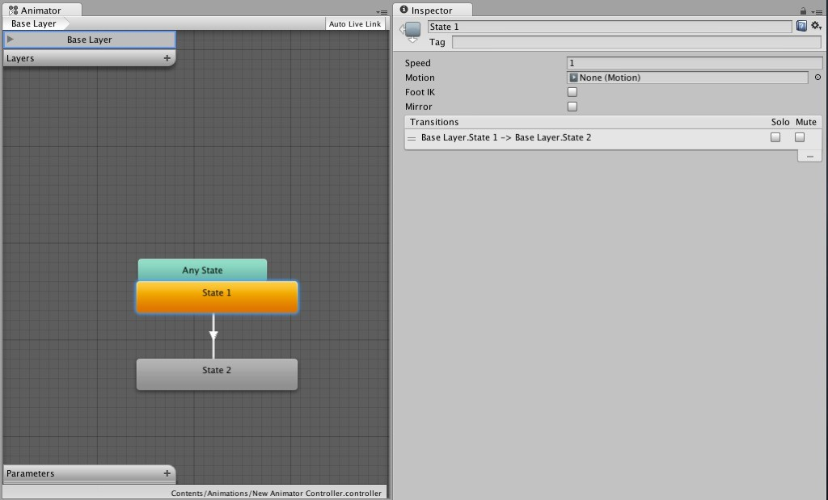


The Animator Controller

Slide 27

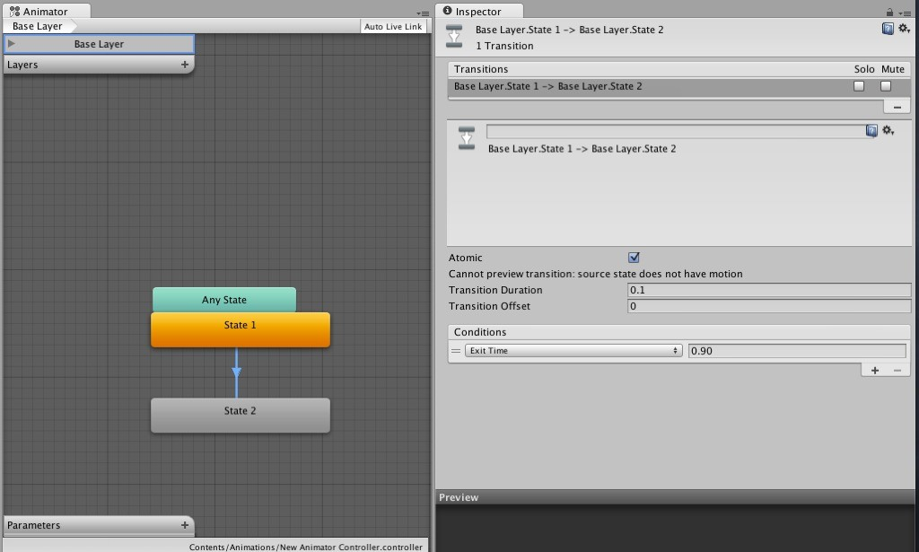



The Animator Controller

Slide 28
State Transitions
•
Transition Duration
•
Time in seconds that the transition takes to complete from one animation state to the next.
•
Increasing this value will make the transition slower.

Slide 29


The Animator Controller

Slide 30
State Transitions
•
Conditions
•
Logic checks, similar to if-statements in code.
•
Default is Exit Time.
•
Exit Time
•
Duration in seconds to wait within a state before transitioning to the next one.

Slide 31

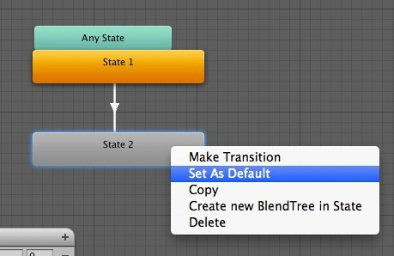

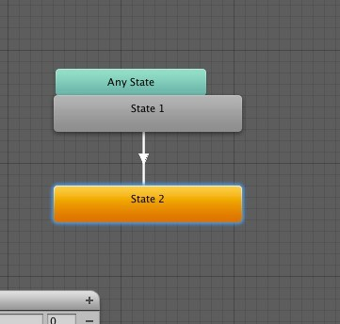
The Animator Controller

Slide 32
Parameters
•
Animation states are controlled by parameters.
•
Parameters get their values from script code.
•
When a parameter is changed, the state transition can check if the parameter value satisfies the transition condition.
•
E.g. (speed > 1) means transition to run animation.
•
If a condition is satisfied, transition occurs from current state to the next state pointed by the transition arrow.

Slide 33
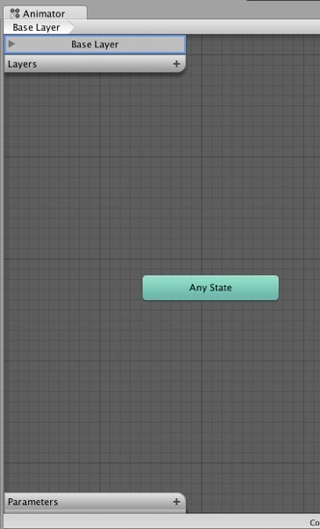


Parameters
•
Created by clicking on the + icon.

Slide 34

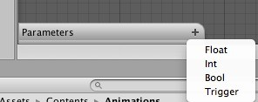


Parameters
•
Created by clicking on the + icon.
•
Set parameter type.

Slide 35

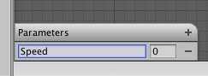


Parameters
•
Created by clicking on the + icon.
•
Set parameter type.
•
Set parameter name.

Slide 36
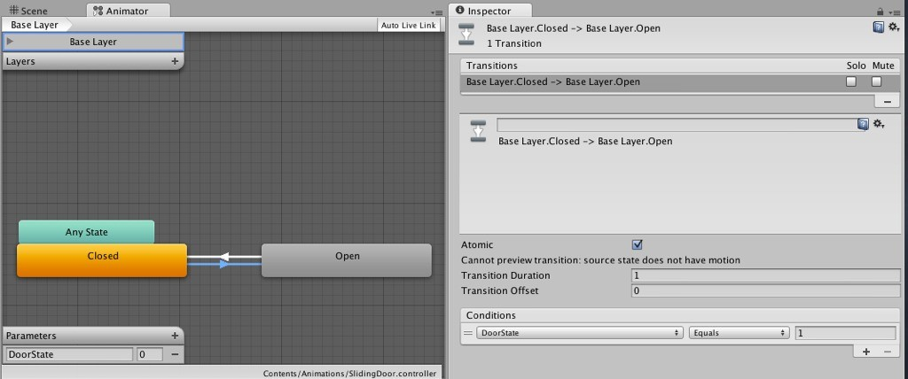



Parameters
if (DoorState == 1)

Slide 37



Parameters

Slide 38

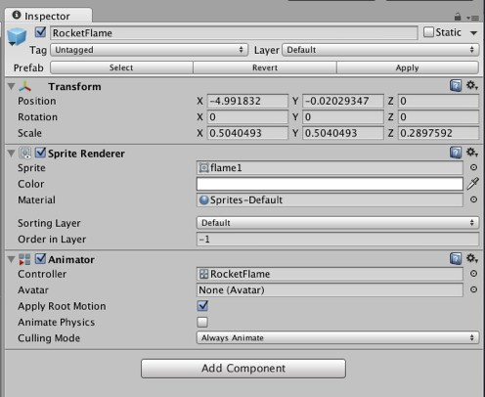

Animator Scripting
•
Declare a reference to the Animator component.
Animator anim =
this.gameObject.GetComponent<Animator>();

Slide 39
Animator Scripting
•
Declare a reference to the Animator component.
public Animator anim = null;

Slide 40
Animator Scripting
•
Pass values to the Animator parameters using Animator’s “set” methods.
•
Which “set” method you call depends on the type of parameter.
SetInteger(“DoorState”, 1);
SetFloat(“Speed”, 2.3f); SetBool(“IsFiring”, true); SetTrigger(“Jump”);

Slide 41

Animation View
Sets how many frames make up a second of animation.
Reducing this number makes the animation slower.

Slide 42
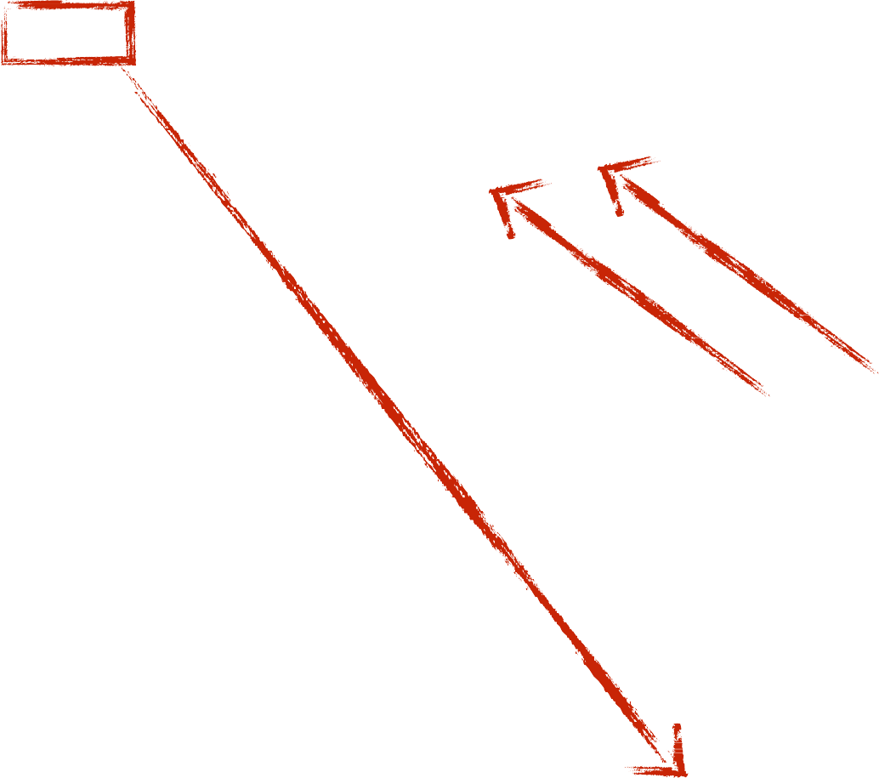
Animation View
keyframes
Allow you to navigate between the keyframes of an animation.

Slide 43

Animation View
Allows you to preview the animation.

Slide 44



Animation View
red when record button is on
currently selected frame indicated by the red scrubber
Changes made to the animated game object (while the record button is on) will be applied to the currently selected frame.

Slide 45

Animation View
Press this button to select which properties of the animated game object you wish to modify this frame. E.g. x, y or z axis.

Slide 46
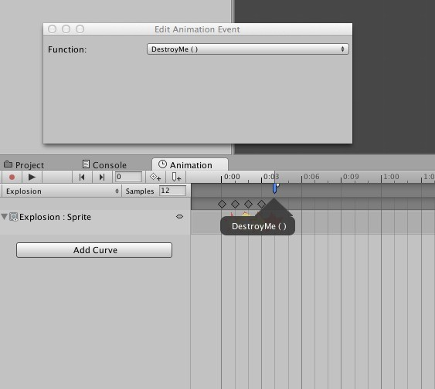


Animation View
Select which function the event will call.
The function exists in the script attached to the animated game object.
You define that script.
Add Event button

Slide 47
Animation Scripting
private void DestroyMe ()
{
Destroy(this.gameObject);
}
In the previous example, the animation event will call this function on the last frame.

Slide 48
Animation Scripting
private void DestroyMe ()
{
Destroy(this.gameObject);
}
This method becomes what is known as a “callback”
Animation callback method can be private

Slide 49
Sliding Door Animation Demo

Slide 50
SetActive()
// Deactivate a game object.
// This will make the game object
// It will also halt execution of
// game object’s hierarchy.
and its children all
invisible
in the scene. in the
components
and scripts
someGameObject.SetActive(false);
// Activate a game object.
// This will make the game object
//
//
//
and its children
visible.
It will also re-enable all components
and scripts
in the game object’s
hierarchy that were previously Components disabled through other
disabled
as a result will remain
of SetActive(false). disabled.
means
someGameObject.SetActive(true);

Slide 51
Booleans activeSelf, activeInHierarchy
// Whether the game object has been activated via SetActive(true) call
// or deactivated via SetActive(false) call.
someGameObject.activeSelf;
// Whether
//
//
the game object
has been activated
or deactivated by
SetActive(true) or SetActive(false) and not the game object itself.
being
called
on one of its
parents.
someGameObject.activeInHierarchy;
•
•
Use these to check if a game object is visible.
Depending on the situation, you will likely use activeSelf more than activeInHierarchy.

Slide 52
Rocket Thruster Demo

Slide 53
By the end of this week
•
Assignment 1 will be posted on Blackboard
•
Assignment 1 submission is to be made on Blackboard
•
Do not email me the assignment unless you have trouble submitting it to Blackboard

Slide 54


Slide 55
Game Design
The best way to do this is by sketching up the following things:
The core game mechanics, including a level concept if applicable
A rough backstory with the main characters
A list of items, power-ups, or other things that modify the characters, mechanics, or environment if applicable
A rough sketch of the graphics style based on the backstory and characters
Sketches of all the screens involved, diagrams of transitions between screens, and transition triggers

Slide 56
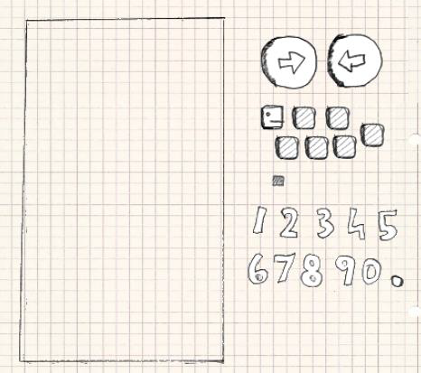
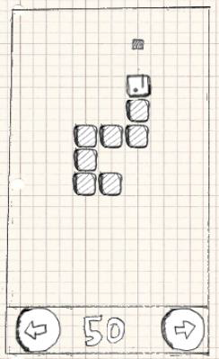
Game Design for 2D Snake game
Game design building blocks
The initial playing field

Slide 57
Game mechanics (Sample description)
snake advances in the direction in which its head is pointed, dragging along its tail
if the snake goes outside the screen boundaries, it reenters the screen on the opposite side
if the right or left button is pressed, the snake takes a 90-degree clockwise (right) or counterclockwise (left) turn
if the snake hits itself the game is over
if the snake hits a piece with its head, the piece disappears, the score is increased by 10 points, and a new piece appears on the playing field in a location that is not occupied by the snake itself
the snake also grows by one tail part
that new tail part is attached to the end of the snake

Slide 58

A Story and an Art Style
Mr. Nom is a paper snake who's always eager to eat drops of ink that fall down from an unspecified source on his paper land.
Mr. Nom is utterly selfish, and he has only a single, not-so-noble goal:
becoming the biggest ink-filled paper snake in the world
Nom, his hat, ink stains, and the logo

Slide 59
Screens and Transitions
A screen (scen)
an atomic unit that fills the entire display, and it is responsible for exactly one part of the game (for example, the main menu, the settings menu, or the game screen where the action is happening/level).
You may also have scenes in which menu is overlaid over the play
Can be composed of multiple components
game objects, buttons, controls, head-up displays, or the rendering of the game world
allows the user to interact with the screen’s elements.
These interactions can trigger screen transitions

Slide 60

Screens and Transitions
Name of our game
Play button to start the game
High score button to view the top scores
Help button for users that do not know how to play the game
Toggle sound button
The main menu screen

Slide 61
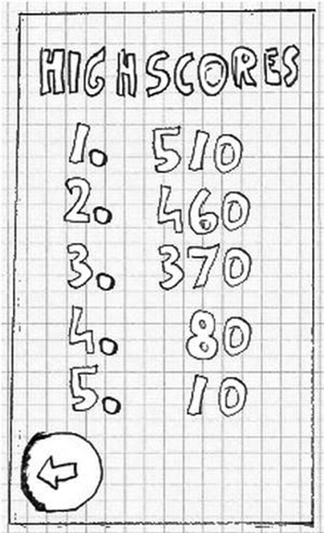
Screens and Transitions
only the five highest scores will be recorded
single button with an arrow on it to indicate that you can transition back
The high-scores screen

Slide 62
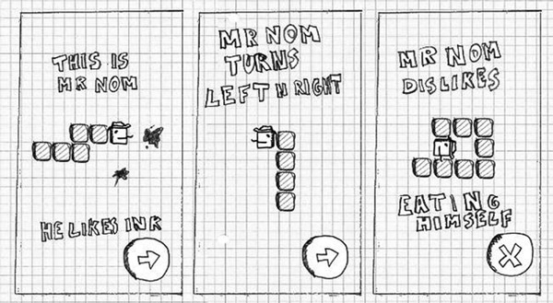
Screens and Transitions
It will inform the player of the backstory and the game mechanics
The help screens

Slide 63
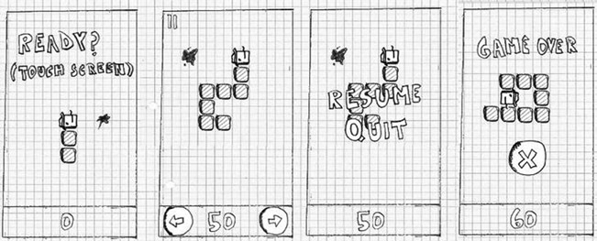
Screens and Transitions
The game shouldn’t start immediately
we should give the player some time to get ready.
We’ll also add a button that allows the user to pause the game
We need to inform the player that the game is over
The game screen and its four different states

Slide 64
Screens and Transitions
From the main menu screen we can get to
the game screen
the high-scores screen
the help screen
From the game screen
we can get back to the main menu screen either via the button in the paused state or the button in the game-over state.
From the high-scores screen
we can get back to the main menu screen.
From the first help screen
we can go to the second help screen
From the second to the third
From the third to the fourth
From the fourth, we’ll return back to the main menu screen.

Slide 65
